Slide 1

Animation
Programming concepts:
Events & Animation

Slide 2
Last Weeks
Previously
Variables : int, float
Loops : for & while
Drawing commands : ellipse, line, point etc
Procedures
Top Down Design
Modularised code : procedures (void functions), functions (video)
Parameter passing
Global & local variables

Slide 3
Learning Objectives
Animation
Events : setup, draw
setup() : program starts here, runs once through commands
draw() : repeats commands 60 times per sec
Notes:
If we met last week, expand a little more here

Slide 4
Type in to Processing
void setup() //run once
{
size(500, 500);
}
void draw() //run every 60th of a second
{
ellipse(mouseX, mouseY, 40, 40); //mouse position
}

Slide 5
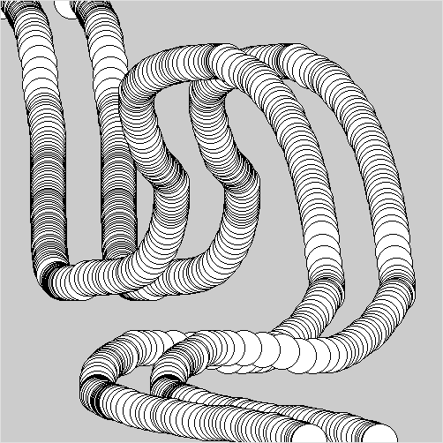
Exercise 2.
Alter the code so that we see two parallel lines of circles, one offset, to the right, from the first by 50 pixels as in the picture.

Slide 6
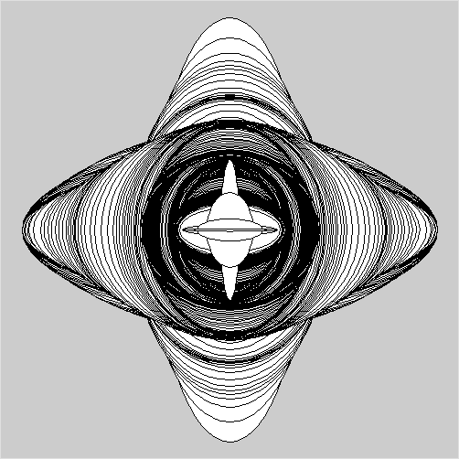
Exercise 3.
Alter the code so that ellipse remains in the centre of the screen, but the mouseX and mouseY alter the width and height of the ellipse.
Add an if statement, so the width and height have a max value of 100.

Slide 7
Exercise 4.
background(red, green, blue); //fills whole canvas
Write a program which draws 3 concentric circles at the mouse position (leaving no trail). Remember to consider where the background command is placed, this commands clears the screen in a given colour.

Slide 8
Exercise 5
Experiment with the code that allows a circle to be dragged (assignment specification).
Set circle to initialise bottom right
Change colour for mouseover to RED
Change circle to be two concentric circles
Can you remove the circle from the screen if its dragged with 50 pixels of top left corner?

